Slide 1
Course Code: CSC566 Course Name: Image Processing

Slide 2
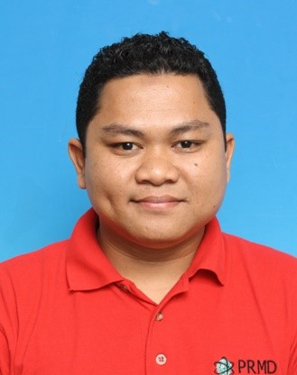
Instructor
Ts. Zaaba Ahmad
zaaba.ahmad@uitm.edu.my
No.26, Block B, Ground Floor
017-2988287

Slide 3
Syllabus Content
Introduction
Fundamental issues of image processing
Applications for image processing
Human visual perception
Components of image processing system
Image models, representation and properties
Human visual perception
Electromagnetic spectrum
Image properties
Sampling and Quantization
Image acquisition
Spatial and Fourier domain
Image sampling and quantization

Slide 4
Syllabus Content
Enhancement
Graylevel transformation
Histogram Processing
Logical and arithmetic operations
Image filtering: average, median, min, max
Image sharpening
Morphological Operations
Dilation and erosions
Opening and closing
Thinning and thickening
Image Segmentation
Relationships between pixels
Line, edge, boundary detection
Global and local thresholding
Region growing
Split and merge

Slide 5
Syllabus Content
Color Image Processing
Color models
Color segmentation
Color smoothing and sharpening
Representation and Description
Shape descriptors
Color descriptors

Slide 6
Course Assessment
Assessment 1 10%
Assessment 2 10%
Asessement 3 20%
Test 20%
Mini Project 40%
=======================
Total 100%

Slide 7
Recommended Text
Nursuriati Jamil & Khalil Awang. Practical Digital Image Processing with MATLAB, 2014.
Gonzales, R.C. and Woods, R.E. Digital Image Processing. (3rd Edition), Prentice Hall, 2008

Slide 8
References
Sonka, M,, Hlavac V and Boyle. Image Processing, Analysis and Machine Vision. Thomson, 2007.
Pratt, W.K.. Digital Image Processing. John Wiley Interscience, 2007.
Petrou, M. and Bosdogianni, P. Image Processing: The Fundamentals. Jihn Wiley & Sons, 2003

